Slide 1

"EMPOWER HER" Real-Time Scream Detection for Women's Safety and Crime Prevention

Slide 2



MEET OUR TEAM
EmpowerHer
DEEPITHA M
SHAHILA SULTHANA B​
Second Year
Department of Artificial Intelligence and Data Science

Slide 3
PROBLEM

Slide 4

PROBLEM
RISING THREAT OF HARASSMENT AND VIOLENCE AGAINST WOMEN IN PUBLIC SPACES
The increasing rates of harassment and violence against women highlight a critical need for enhanced safety measures. Many incidents go unnoticed or unreported due to the lack of real-time detection and response. No solution exists that can instantly detect distress signals, like screams, and alert authorities is essential to ensure timely intervention and improve women’s safety.

Slide 5



DEATHS DUE TO HARRASMENTS
IN INDIA
AGE: 23 YRS
16th December 2018
AGE: 8 YRS
10th January 2018
AGE: 31 YRS
9th August 2018
Source: INDIAN EXPRESS https://indianexpress.com/article/opinion/columns/rape-victims-given-nams-nirbhaya-abhaya-rg-kar-kolkata-case-9559621/

Slide 6

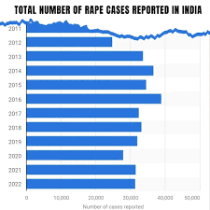
STATISTICS OF SEXUAL HARASSMENTS
IN INDIA
India reported 88 rape cases
everyday
Source: National Crime Records Bureau (NCRB) ps://en.wikipedia.org/wiki/Rape_in_India

Slide 7

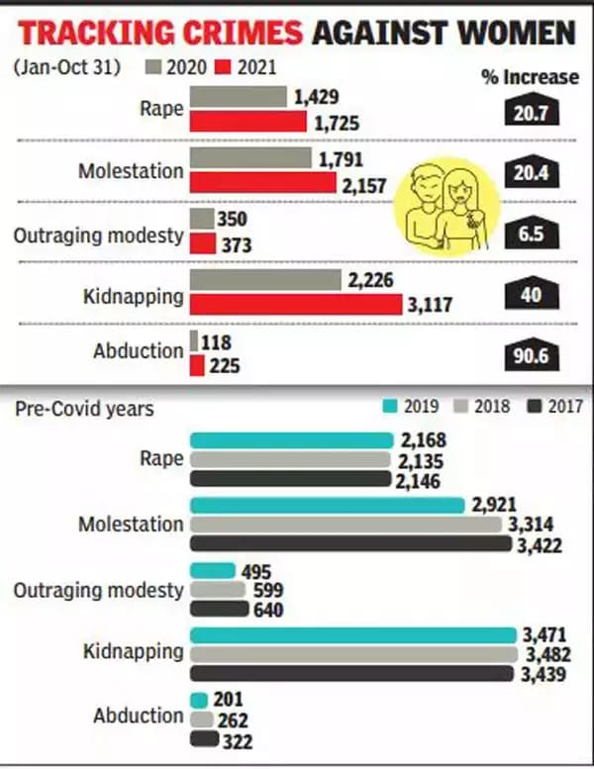
Not Just a Number!
Source: https://timesofindia.indiatimes.com/city/delhi/rape-molestation-cases-up-20-in-delhi-this-year/amp_articleshow/87595386.cms

Slide 8
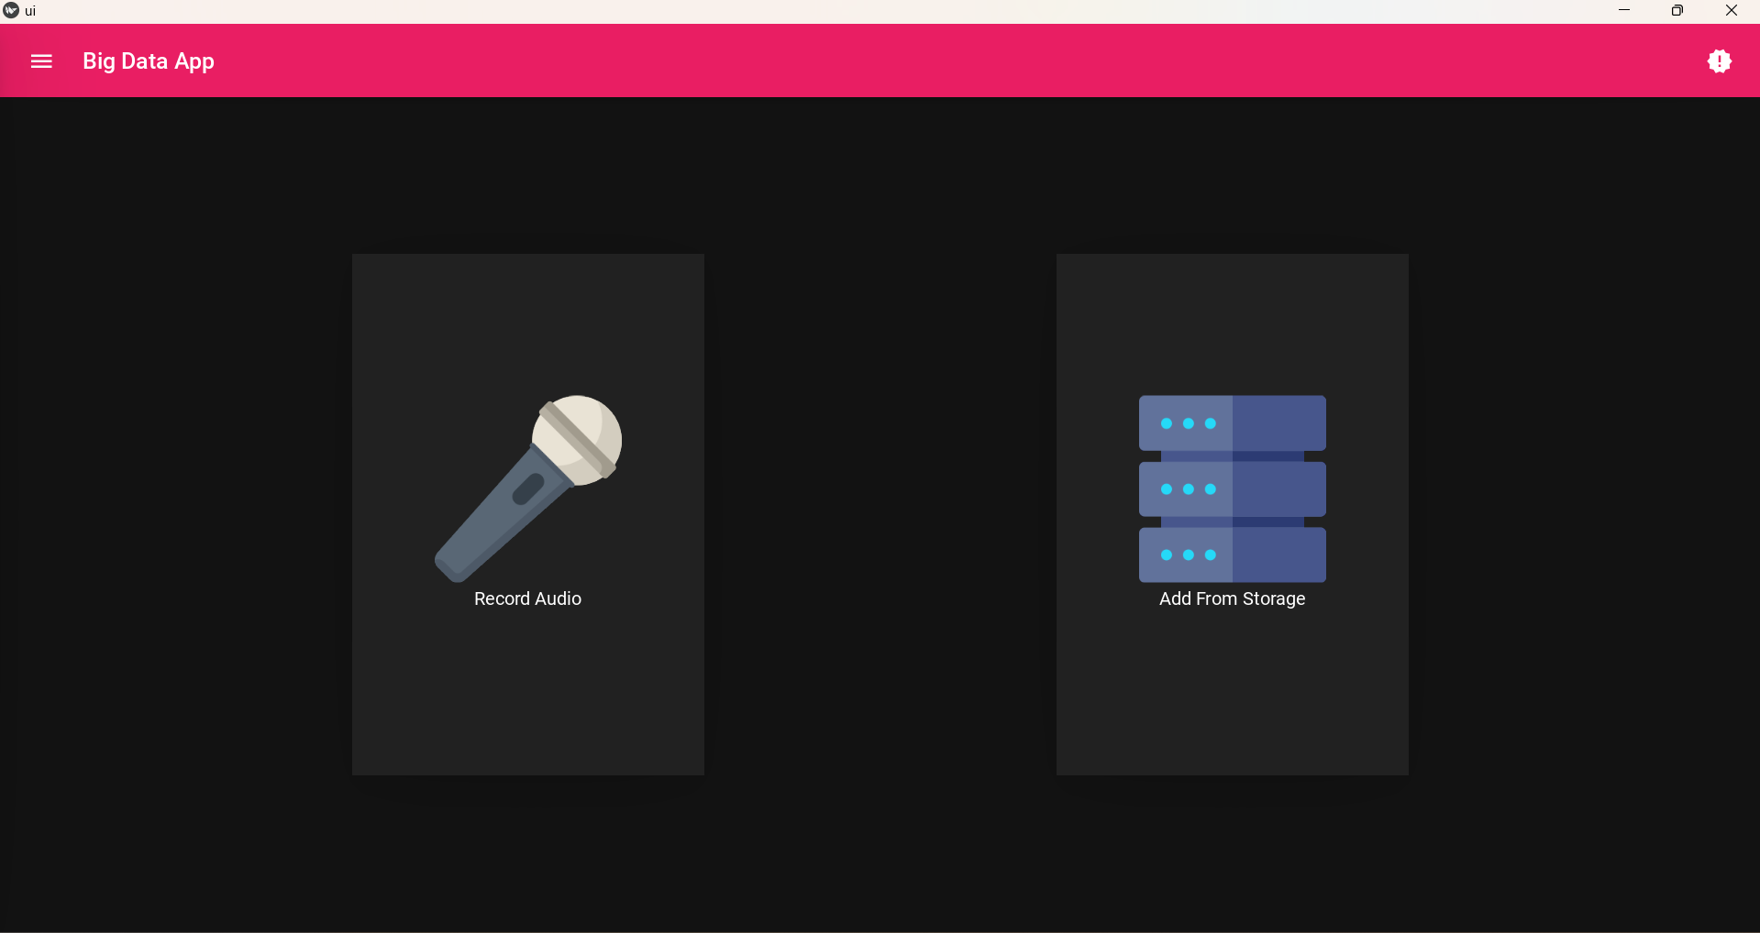
IS THIS A SOLVABLE PROBLEM ?
OF COURSE IT IS!
EMPOWERHER
Yes! ...protecting women from harassment is achievable with EmpowerHer. The system uses real-time scream detection to accurately distinguish distress signals from background noise. By employing machine learning and deep learning, it sends instant alerts to authorities or trusted contacts with the victim's location. This proactive approach ensures immediate intervention, significantly enhancing women's safety in public and private spaces.

Slide 9

WHY IS THIS MODEL REQUIRED ?
Increasing Harassment: Growing safety concerns for women.
Slow Response: Existing measures lack immediate action.
Instant Detection: Enables real-time alerts and intervention.
Proactive Protection: Reduces risk through early response.
AI-Driven Solution: Efficient and scalable for enhanced safety.
Source : https://www.hindustantimes.com/cities/chandigarh-news/two-rape-cases-in-24-hrs-in-doraha-101720545329339-amp.html

Slide 10
FEATURES
OF OUR MODEL
Real-time monitoring of the environment
Detection of distress screams
Enhanced safety through prompt alerts
Automatic location sharing
Strong privacy protections
Learning capabilities for improved accuracy
Multi-platform compatibility
Community awareness to combat harassment.

Slide 11
TOOLS AND TECHNOLOGIES
The whole project back-end is developed using python language
Kivy framework is used in this project to design the interface of the application which is suitable for both desktops as well as Android applications.
SVM (Support Vector Machine) of Machine Learning is used for the detection and classification of screams.
Multilayer perceptrons model of Deep learning is used for the confirmation of detected screams.
Integration with location services for SMS Alerts

Slide 12
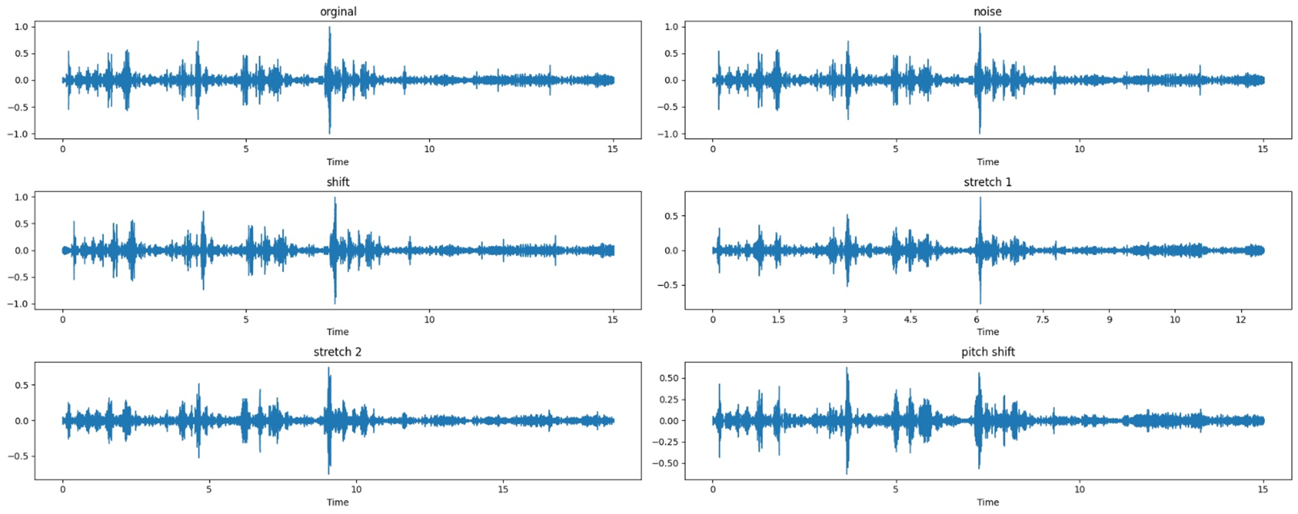
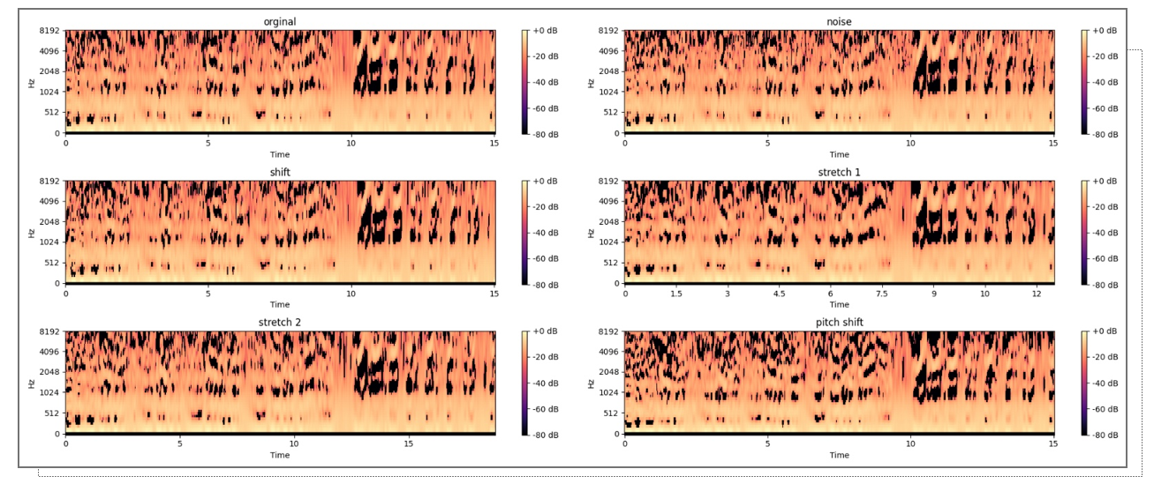
MODEL ARCHITECTURE
Working of Librosa Software and MFCCs

Slide 13
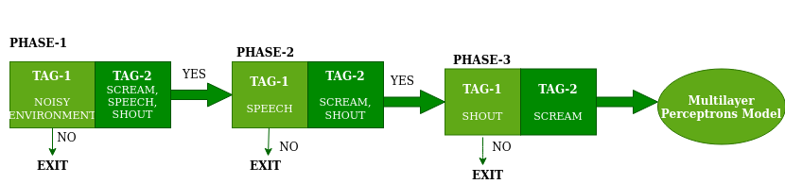
MODEL ARCHITECTURE
Detection of noise, speech, shout and scream using SVM classifier

Slide 14
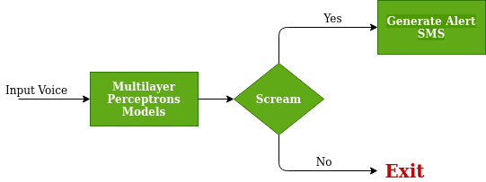
MODEL ARCHITECTURE
Working of MPN

Slide 15
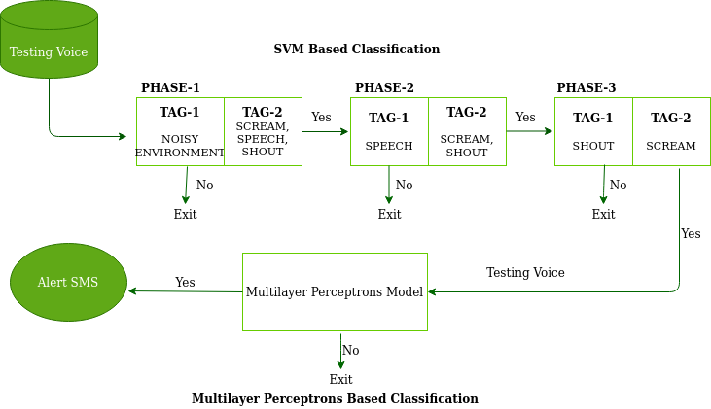
MODEL ARCHITECTURE
Combined internal working of both models (SVM and MPN)

Slide 16
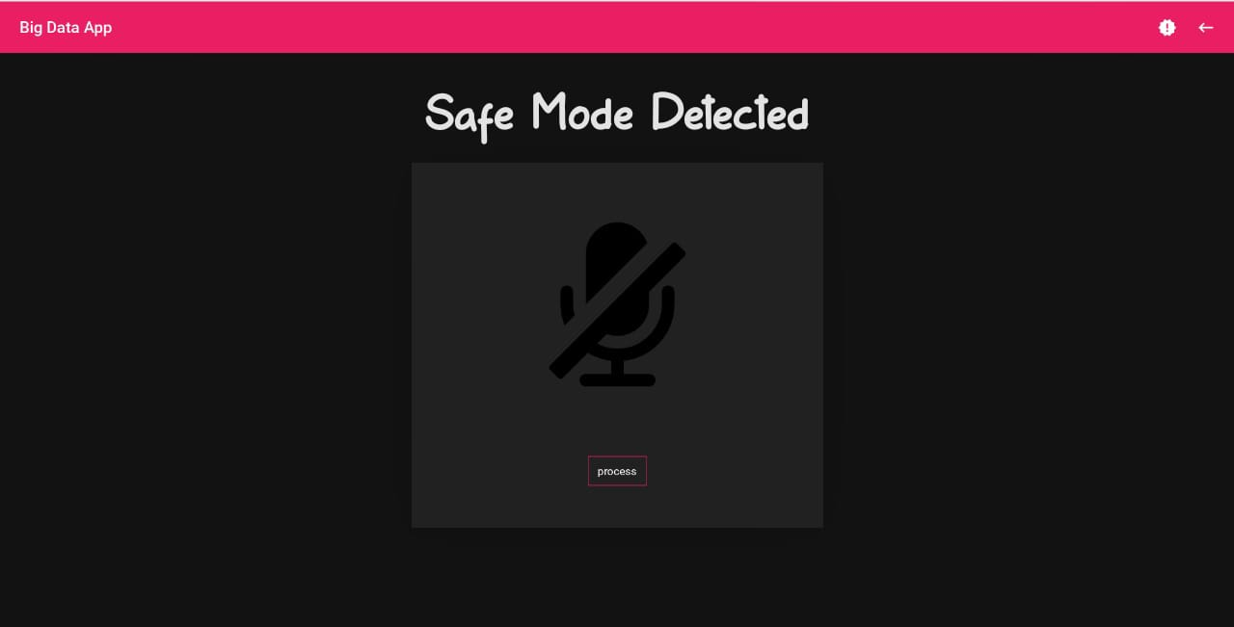
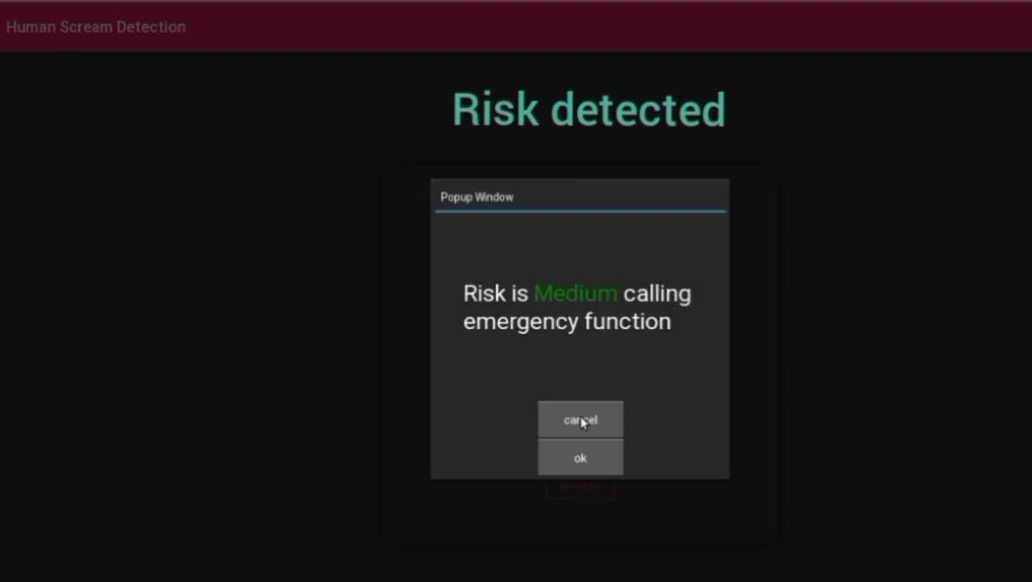
ALERT MESSAGE
No sign of Danger
Victim is in Danger
SMS messages shared along with location

Slide 17

HOW DOES THIS HELP ?
Real-Time Detection: AI detects distress screams instantly.
High Accuracy: Differentiates distress from background noise.
Instant Alerts: Sends location-based emergency alerts.
Proactive Protection: Prevents harassment through early intervention.
Scalable Solution: Can expand for broader safety applications.

Slide 18
IMPACT
Increased Safety: Provides real-time detection and alerts, enhancing personal protection.
Faster Response: Enables authorities to respond quickly to harassment incidents.
Empowerment: Gives women more control over their safety.
Crime Deterrence: Discourages potential offenders.
Vulnerable Group Protection: Helps women in high-risk areas.
Community Awareness: Promotes collective action against harassment.
Technological Innovation: Drives further safety tech advancements.
Data-Driven Insights: Helps authorities improve safety measures.
Peace of Mind: Reduces fear, allowing women to move more freely.

Slide 19

TARGET AUDIENCE
Women of All Ages
Female Students
Victims of Harassment
Community Leaders
Working Women

Slide 20
MARKET OPPORTUNITY
Growing Demand for Women’s Safety Solutions: Rising concerns about harassment drive demand for real-time safety apps like EmpowerHer.
Expanding Safety Tech Industry: EmpowerHer leverages AI and machine learning, aligning with the growing market for innovative personal safety solutions.
Corporate Interest in Employee Safety: Companies can adopt EmpowerHer to ensure safety for female employees, especially in high-risk work environments.
Smartphone Penetration: With smartphones being widely accessible, EmpowerHer has a large potential user base for its app-based safety solution.

Slide 21
BUSINESS MODEL

Slide 22
VALUE PROPOSITION
Real-Time Protection: Provides instant alerts during critical moments, enabling rapid intervention.
High Accuracy: Uses AI to distinguish distress screams from background noise, ensuring reliable detection.
Seamless Location Sharing: Automatically sends the victim's location to authorities or trusted contacts for quick response.
User-Friendly App: Intuitive, easy-to-navigate interface for quick access in emergencies.
Empowering Women's Safety: Offers peace of mind by enhancing personal safety in both public and private spaces.

Slide 23
FUTURE PLANS AND MILESTONES
Emotional Monitoring via Wearables: Integrating heart rate tracking in wearables to detect emotional distress like fear or anxiety for earlier intervention.​
Detection of Additional Distress Sounds: Expanding to detect other emergency sounds like breaking glass, gunshots, and vulnerable cries for broader threat coverage.​
Enhanced Alert Systems: Sending alerts to large public areas like malls and metro stations, in addition to police, for faster community response and support.​
CCTV Tracking: Linking with local CCTV systems to provide real-time footage of the area where the distress was detected, enhancing situational awareness.​

Slide 24
CONCLUSION
EmpowerHer represents a significant step forward in utilizing technology to enhance women’s safety. By leveraging AI-powered scream detection and real-time location-based alerts, this solution offers immediate protection during emergencies. EmpowerHer ensures timely intervention, potentially saving lives and reducing harassment incidents. Its user-friendly design makes it accessible to women of all age groups, empowering them to feel secure in both public and private spaces. As the world increasingly focuses on safety and protection, EmpowerHer provides a reliable, proactive approach that aligns with global efforts to create a safer environment for women.

Slide 25
THANK YOU

